Slide 1
House Healthcare Subcommittee of the Legislative Oversight Committee Presentation
March 17, 2015

Slide 2
Executive Staff
V. Susan Alford State Director 898-1390
Holly Pisarik Special Assistant to State Director 898-1390
Jessica Hanak-Coulter Deputy State Director for 898-1370
Human Services
Amber Gillum Deputy State Director for 898-7305
Economic Services
Katie Morgan Director, Integrated Child 898-1519
Support Services
William Bray Liaison to House Legislative 898-7225
Oversight Subcommittee

Slide 3
Agency Mission
To effectively and efficiently serve the citizens of South Carolina by ensuring the safety of children and adults who cannot protect themselves and helping families achieve stability through child support, child care, financial and other temporary benefits while transitioning into employment.

Slide 4
DSS State FY 2014-15 Appropriations
Notes:
William: Add total funds
For my presentation notes, need clarification as to what kinds of funds fall within earmarked and restricted funds

Slide 5
DSS State and Regional Locations
State Office-Columbia, SC
Confederate Avenue (Primary)
Harden Street (Child Support)
Browning Road (IT/Security/CSES)
Adoptions
6 regional offices across the state
Intensive Foster Care and Clinical Services(IFCCS)
14 regional offices
Child Care
4 regional offices
Child Support
4 regional offices
Note: Some of these regional offices share physical space.
Notes:
William: List our state buildings and our regional offices

Slide 6
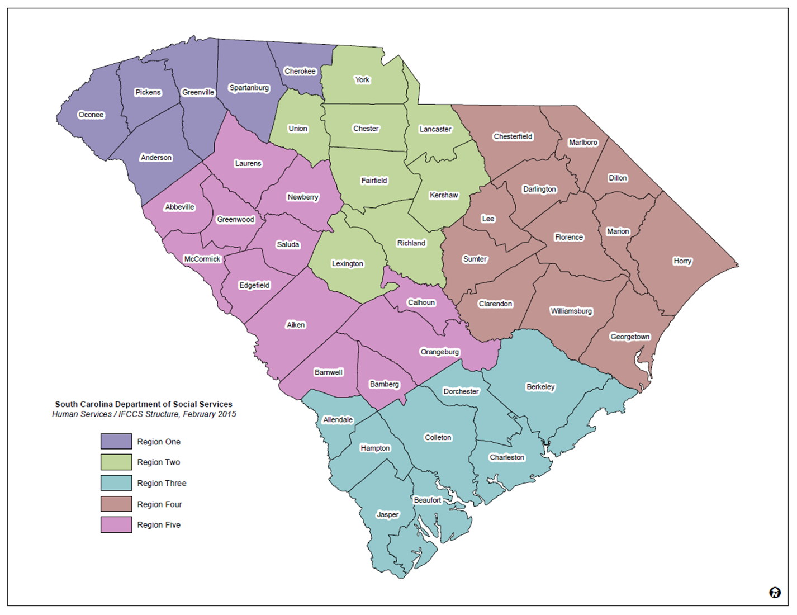
Map of Primary County Offices
Notes:
William: Is there a color map? This doesn’t look polished

Slide 7
Major Functions of DSS
Human Services
Economic Services
Integrated Child Support Services

Slide 8
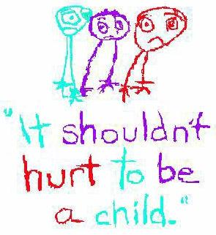
Major Functions of Human Services
Child Protective Services
Adult Protective Services
Foster Care
Adoption
Domestic Violence Services
Independent Living

Slide 9
Child Protective Services
Serves children 0 to 18 years old
Child Protective Services receive and investigate reports of child abuse and neglect. These services, provided or coordinated by DSS, are designed to maintain children safely in their own homes when possible, reunite the family as soon as possible or place the children with relatives or in foster or group care, when necessary.

Slide 10
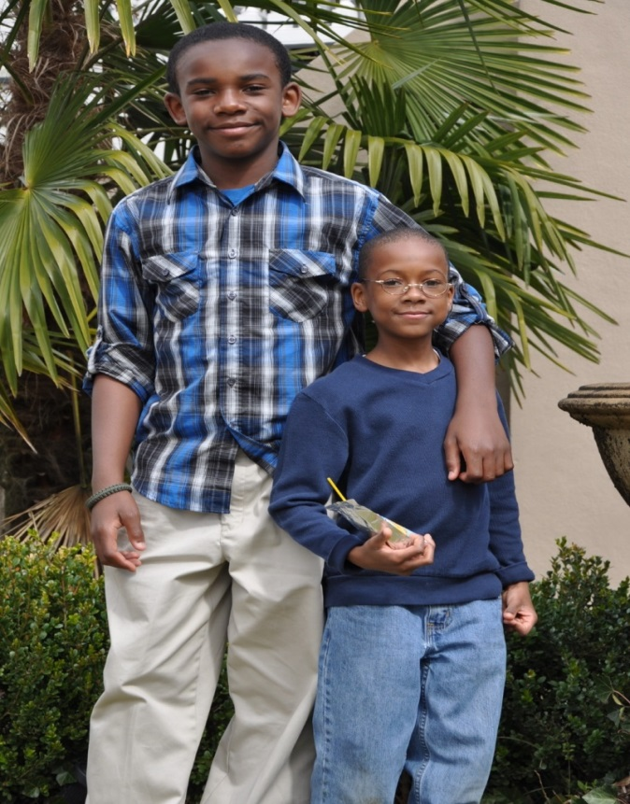
Child Protective Services
Law enforcement has the sole authority to remove children and place into emergency protective custody, or a Family Court Judge can issue an ex parte order for the removal of the child. The Family Court system determines whether children are placed in DSS custody due to abuse or neglect and if termination of parental rights is warranted.

Slide 11
Adult Protective Services
APS – Adults 18 years old and up
Adult Protective Services protect the health and welfare of elderly and disabled adults. These services are provided to individuals who are 18 or older and are victims of actual or potential abuse, neglect or exploitation. This mistreatment may be caused by others or it may be self-inflicted. DSS is authorized to investigate all reports and provide services to meet the adults' basic needs and ensure their safety.

Slide 12
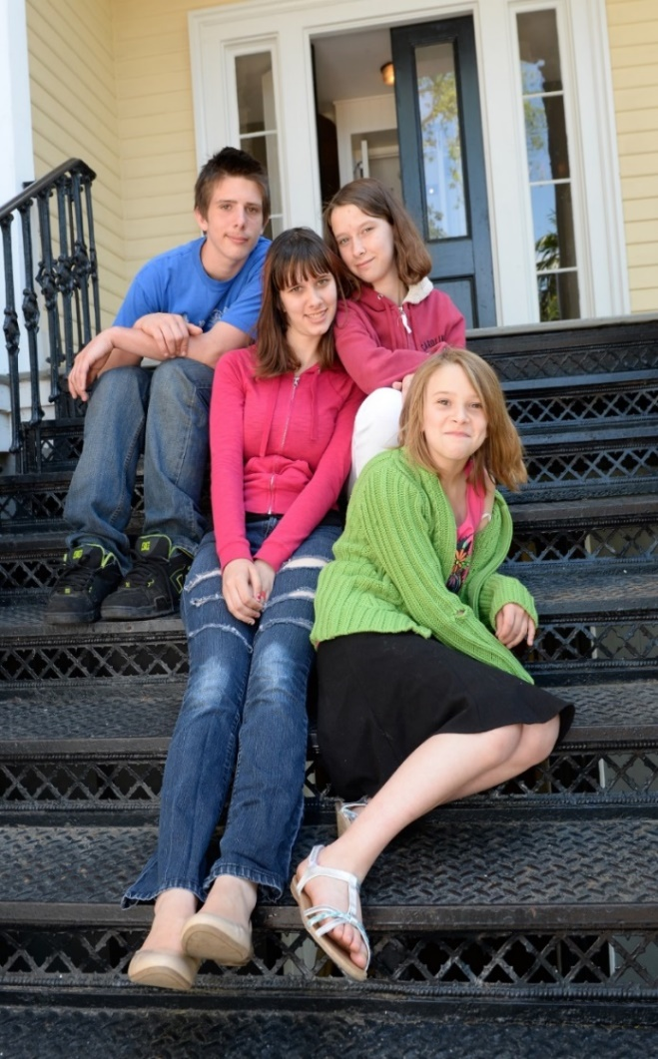
Foster Care
Foster Children – Children 0 to 21 years old
Foster care provides temporary services for children removed from their families because of abuse, neglect or exploitation by a parent or guardian. The SCDSS recruits and licenses temporary foster homes and group care for children, while plans are implemented for permanent placements.
DSS also has specialized treatment and support services for children in foster care who have emotional and behavioral problems through the Intensive Foster Care and Clinical Services Office (IFCCS). When a child is identified with emotional/behavioral problems, DSS arranges for an interagency staffing on the child, to determine whether the child needs services through the Interagency System for Caring for Emotionally Disturbed Children (ISCEDC), and to identify the most appropriate services that can best meet the individual child’s needs.
Notes:
William: The description you had on this slide had too much information. We just need a brief description of what foster care does. I put something in here, but change slide text if needed.

Slide 13
Adoption
DSS facilitates adoption for the children in its custody who are unable to be returned to their homes. Adoption services include assessment and preparation of children for adoption, recruitment of adoptive families, placement of children in adoptive homes, and financial subsidization of the costs of the adoption proceeding.
A large number of children available for adoption are older, from ethnic minorities or racially mixed backgrounds, have physical or emotional handicaps or are members of sibling groups.

Slide 14
Domestic Violence Services
DSS partners with other state agencies such as the Department of Public Safety and the Department of Health and Environmental Control in an effort to develop and maintain best practices in domestic violence prevention and works closely with shelter programs and batterer intervention providers by providing technical assistance related to policy and best practices development.

Slide 15
Independent Living
Independent Living is defined as an array of services provided to adolescents ages 13 to 21. The purpose of the Independent Living program is to provide the developmental skills necessary for foster adolescents to live healthy, productive, self-sufficient and responsible adult lives. The program's overall goal is to provide foster adolescents with opportunities to learn needed independent living skills and increase the likelihood of their successful transition from the foster care system.

Slide 16
Human Services Key Outcomes
Timely Initiation of CPS Assessments
Timely Completion of CPS Assessments
Monthly Visits in Foster Care
Stability of Foster Care Placements (2 or fewer placements)
Timely Initiation of APS Assessments
Timely Completion of APS Assessments
Notes:
William: Just list the key performance measures as bullets…no data
Timely initiation and completion of CPS and APS assessments and investigations
Monthly visits in foster care
Increased stability of foster placements
Permanency goals for children in foster care
Increased health services provided to children and adults

Slide 17
Major Functions of Economic Services
Family Independence (TANF cash assistance)
Supplemental Nutrition Assistance Program (SNAP)(“food stamps”)
Food Assistance Programs
Child Care Licensing and Vouchers
Employment & Training Programs
Notes:
William: You have descriptions that follow of the first 4 bullets, but nothing about employment and training programs

Slide 18
Family Independence (TANF)
Family Independence (FI) is South Carolina’s TANF program. FI is a 24-month time-limited program that provides cash assistance and employment & training services for parents with dependent children. Persons caring for a relative's child are also eligible.
In January 2015:
Families Served = 12,387
Average Benefit Amount = $216
Average Household Size = 2.27
Notes:
William: added per month

Slide 19
Supplemental Nutrition Assistance Program (SNAP)
SNAP (“food stamps”) is a federal program designed to help families and individuals buy the food they need for a nutritionally adequate diet. Benefits are distributed though Electronic Benefits Transfer, or “EBT cards”.
In January 2015:
Households Served = 382,860 (809,770 individuals)
Average Monthly Benefit = $264
Average Household Size = 2.11
SNAP policy is based on federal regulations. DSS determines eligibility and administers employment & training programs for recipients.

Slide 20
Food Assistance Programs
Senior Farmers’ Market Nutrition Program (SFMNP): provides fresh, locally grown fruits and vegetables to low-income seniors. Serves approximately 25,000 each year.
Child & Adult Care Food Program (CACFP): provides meal reimbursements to child care centers and adult day care centers for serving nutritious meals. Over 20 million meals served in FFY 2014.
The Emergency Food Assistance Program (TEFAP): provides low-income Americans, including elderly people, with emergency food and nutrition assistance at no cost. Administered through local food banks.
Commodity Supplemental Food Program (CSFP): food purchased by USDA, and distributed through local food banks. Available to low-income individuals over age 60 in 15 Counties. Participants receive a monthly package of food and are provided nutritional education.
Emergency Shelter Program (ESP): provides meal reimbursements to emergency and homeless shelters, battered women's shelters, and facilities that provide temporary shelter to children age 18 and younger and their families.

Slide 21
Child Care
DSS licenses and regulates child care centers and family child care homes across the state, and provides child care assistance for parents participating in TANF work programs, working parents transitioning from Family Independence, and families in active CPS cases. DSS maintains a listing on its website of childcare facilities registered or licensed by the Department.
DSS also administers the Advocates for Better Care (ABC) Quality Program, a voluntary quality rating and improvement system for childcare providers.
Registered Family Childcare Homes 1,157
Licensed Family Childcare Homes 14
Registered Faith-Based Centers 215
Licensed Childcare Centers and Group Homes 1,531
Total Facilities 2,917
Notes:
William: Add sentence about registered homes and the registry we maintain
Add number of homes that are on registry.

Slide 22
Employment & Training
TANF Employment & Training activities include: Employment Preparation, Supervised Job Search, Work Experience, On-the-Job Training, and Community Service.
SNAP Employment & Training activities include: Job Search Training, Supervised Job Search, Education, Vocational Training, Work Experience, and Workforce Investment Act (WIA) services.
Participation is mandatory in both programs for certain populations (e.g., work-eligible TANF recipients, Able-Bodied Adults Without Dependents receiving SNAP).

Slide 23
Economic Services Key Outcomes
Timely Processing of FI Applications
Timely Process of SNAP Applications
SNAP Benefits Issued Accurately
ABC Child Care Vouchers Disbursed
Annual Child Care Licensing Visits
Annual Visits to Registered Family Child Care Homes
Notes:
List performance measures as bullets, no data

Slide 24
Integrated Child Support Services
By establishing paternity and establishing and enforcing court ordered child support, the Integrated Child Support Services Division (ICSSD) seeks to ensure that non-custodial parents live up to their financial responsibilities in the raising of their children. These services are available to all citizens regardless of their income.

Slide 25
Major Functions of ICSSD
Establishment of Paternity
- Ensuring both parents are known for every child
Collection and Distribution of Child Support to Custodial Parents
Enforcement of Child Support Orders
Fatherhood Program
- Engaging fathers for the financial, emotional, and physical support of their children.
Child Support Enforcement System (CSES)
Notes:
William: Where are the descriptions of each of these areas which are supposed to follow this slide?

Slide 26
Integrated Child Support Services Key Outcomes
Percentage of Child Support Cases with Child Support Orders Established
Amount of Child Support Collected
Percentage of Child Support Cases Paying on Arrears
License Revocation Notices
Wage Withholding Collections
Non-custodial Parents Referred to Fatherhood Programs
Notes:
Increase the number of child support orders
Increase the amount of child support collected each year
Increase the percentage of cases paying on arrears balances
Add measure for the fatherhood initiative

Slide 27
Examples of DSS Partners
Child Care Facilities
Foster Care Review Board
Citizen Review Panels
State Child Fatality Advisory Committee
Guardian Ad Litem Program
SC Foster Care Parent Association
Group Homes
Law Enforcement
Family Court System
Universities
Non-profits
Children's Services agencies(DJJ, DMH, DHEC, DAODAS, DDSN)
Children's Trust

Slide 28
Fast Facts About DSS
Number of DSS Staff
3,873
Demographics of DSS Staff
13% Male
87% Female
57% African American
41% Caucasian
1% Hispanic/Latino
1% Other
Number of Children in Foster Care
3,851
Foster Care Homes 1,244
Therapeutic Foster Care Homes 1,101
Demographics of Children in Foster Care
51% Male
49% Female
37% African American
54% Caucasian
9% Other
Notes:
William: Insert other facts if you have others of interest

Slide 29
Currently In Focus

Slide 30
Child Welfare Reform Agenda
Caseload reduction
Reduction of staff turnover
Onboarding Caseworkers
Streamlining hiring processes
Career Ladder and staff salary increases
Regional Intake process
Recruitment of Foster Home Beds
Reduction of staff turnover
Oversight of alternative caregivers
Business redesign for foster care licensing

Slide 31
Child Welfare Reform Agenda
Implementation of CQI-use of data reports
Staff Training Plan-records management, continuous training
Plan for utilization of group home beds
Formal Methodology for caseload distribution and allocation of staff
Community Based Prevention Services
County Office Needs-physical plant, resources, etc.
Development of dashboard indicators
Increasing adoptions
Relationships with Law Enforcement
Child fatality statistics
Health Services for children/adults

Slide 32
Sources Available For Review by House Oversight Committee
Senate General Committee – DSS Oversight Committee
Report Pending
Legislative Audit Council
October 2014 – A Review of Child Welfare Services at the
Department of Social Services
DSS Annual Accountability Report
FY 2013-14

Slide 33
Appendix

Slide 34
Major Federal Funding Sources
Temporary Assistance for Needy Families (TANF) - Primary focus of the program is to assist low income families meet basic needs.
Child Care Development Block Grant (CCDBG) – This program assists low-income families with child care services.
Social Service Block Grant (SSBG) – This program provides funds to assist states in delivering social services directed towards the needs of children and adults.

Slide 35
Major Federal Funding Sources
Foster Care: Title IV-E - This program helps to provide safe and stable out-of-home care for children under the jurisdiction of the state or tribal welfare agency until the children are returned home safely.
Adoption Assistance: Title IV-E - This program provides assistance in the adoption subsidy costs for the adoption of children with special needs and who can meet certain eligibility tests.

Slide 36
Major Federal Funding Sources
Child and Adult Care Food Program - This grant assists states, through grants-in-aid and other means, to initiate and maintain nonprofit food service programs for children and elderly or impaired adults enrolled in nonresidential day care facilities, children attending afterschool care programs in low-income areas, and children residing in emergency shelters.
Child Welfare Services (Title IV-B Part 1) - This program funded through the U.S. Administration for Children and Families, promotes states in the development and expansion of a coordinated child and family services program.
Title IV –D – This program enforces the support obligations owed by absent parents to their children, locate absent parents, establish paternity and obtain child, spousal and medical support.

Slide 37
Major Federal Funding Sources
State Administrative Matching Grant for Supplemental Nutrition Assistance (SNAP Admin.) - This program serves as the foundation of America's national nutrition safety net, working to end hunger and improve the health of low-income households by helping families buy the food they need for a nutritionally adequate diet.
Non-Budgeted Federal Program
Supplemental Nutrition Assistance Program (SNAP Benefits) - Food Stamp Coupons are used to improve the diet of low-income households by increasing their food purchasing ability. (SNAP Benefit funds are never in the custody of the State.)

